Slide 1
IST 722 Final Project
Team 1 – Order Fulfillment
Courtney Rowland
Kejal Vyas
Jon Burgess
Wesley Stevens

Slide 2
Business Goals and Processes
Fudgemart acquired Fudgeflix and corporate would like both databases converted into a single data warehouse.
Five initial business processes have been identified to meet the companies needs.
Sales
Order Fulfillment
Inventory Levels
Customer Acquisition
Customer Reviews

Slide 3


Project Goals
Merge FudgeMart and FudgeFlix Databases into a Single Data Warehouse.
Create a Bus Matrix for High-level Dimensional Analysis
Detail-Level Dimensional Modeling Worksheet for Order Fulfillment
Create Data Warehouse with Generated SQL Schema
Stage Source Data and Load into Data Warehouse
Gain BI insights into the Order Fulfillment Process
Construct SSAS Cube
Generate BI Dashboard

Slide 4
Order Fulfillment Business Questions
What months have the highest average fulfillment time? What category of products has the highest fulfillment time during these months?
What was the average order fulfillment time per year? Which categories had a longer time compared to the others?
Which states have the most orders? Perhaps certain regions are more susceptible to order delays than others.
Is there any correlation to the number of orders a company has and their average order fulfillment time?

Slide 5
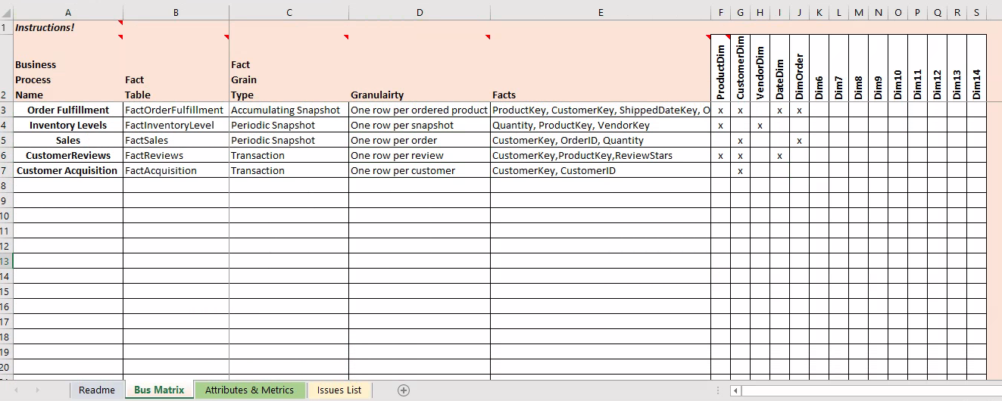
Bus Matrix

Slide 6
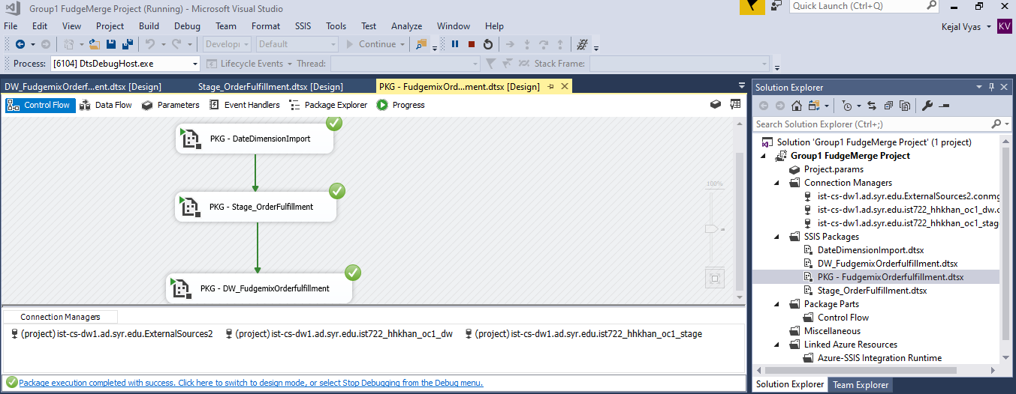
ETL Documentation ScreenShots – Orderfulfill Package

Slide 7
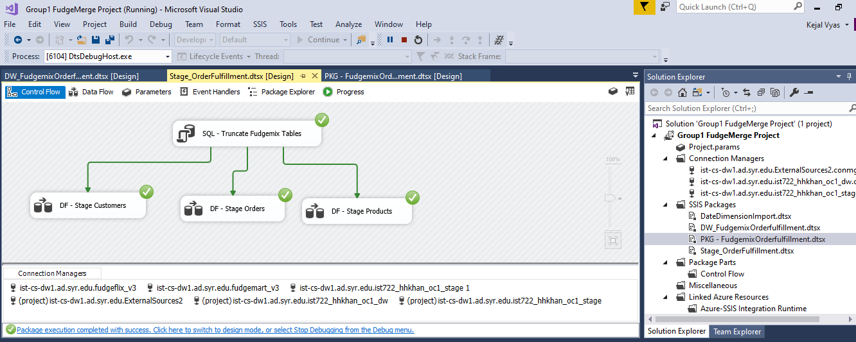
ETL Documentation ScreenShots – Stage

Slide 8
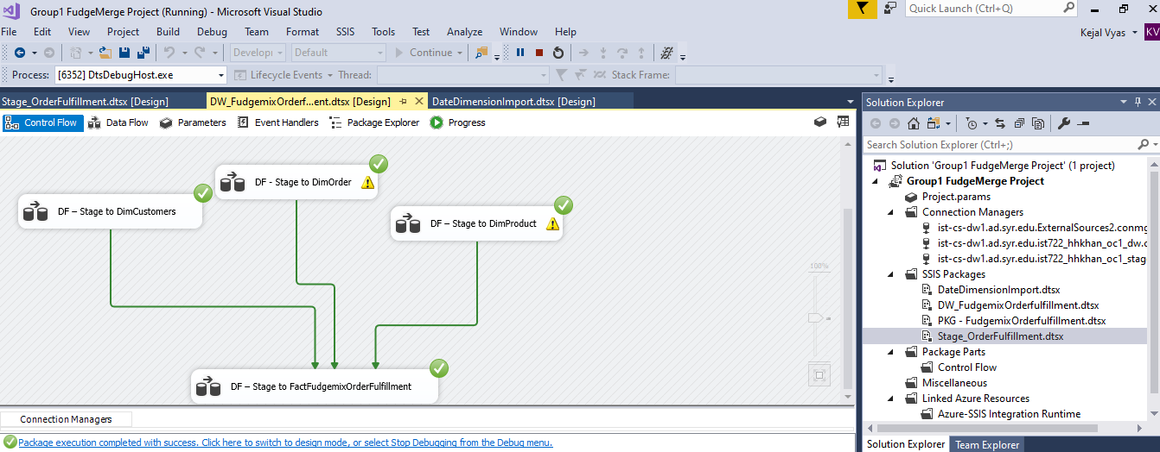
ETL Documentation ScreenShots – DW tables

Slide 9
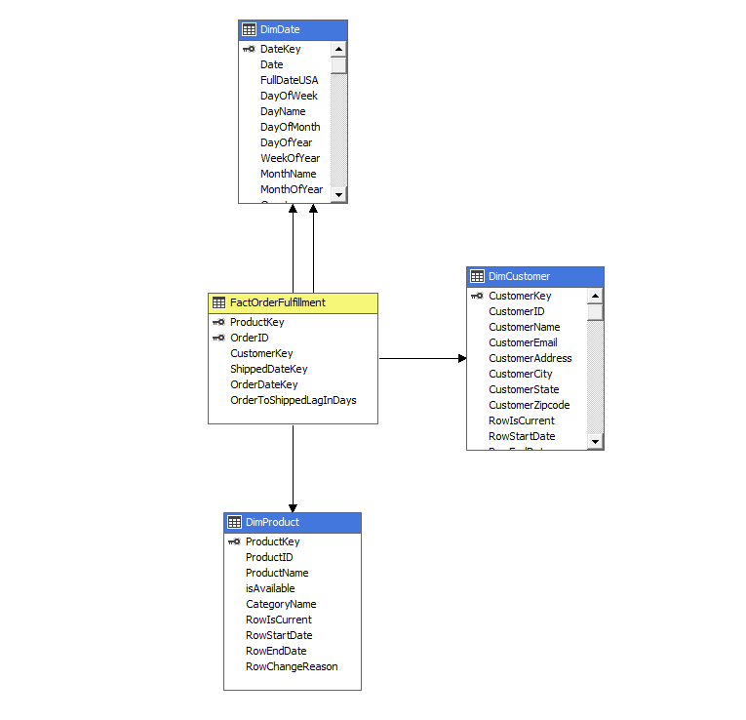
Order Fulfillment Star Schema

Slide 10
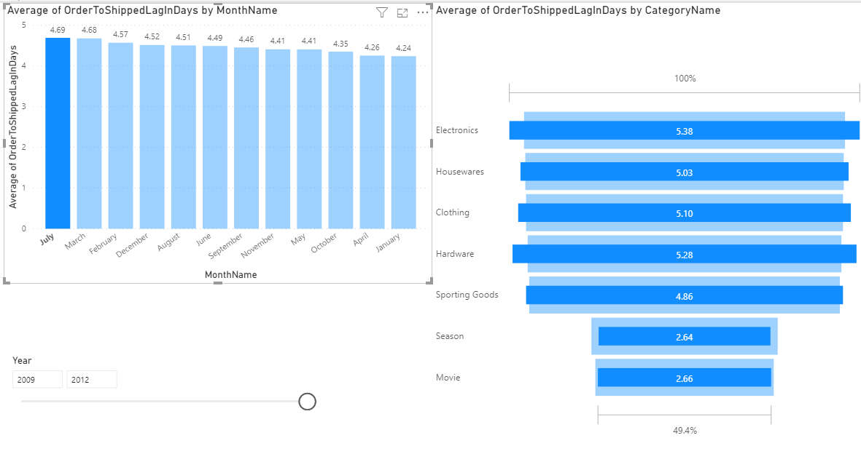
Which Months had the Highest Average Fulfillment Time? Which Categories had the Highest Average Fulfillment Time During this Time?

Slide 11
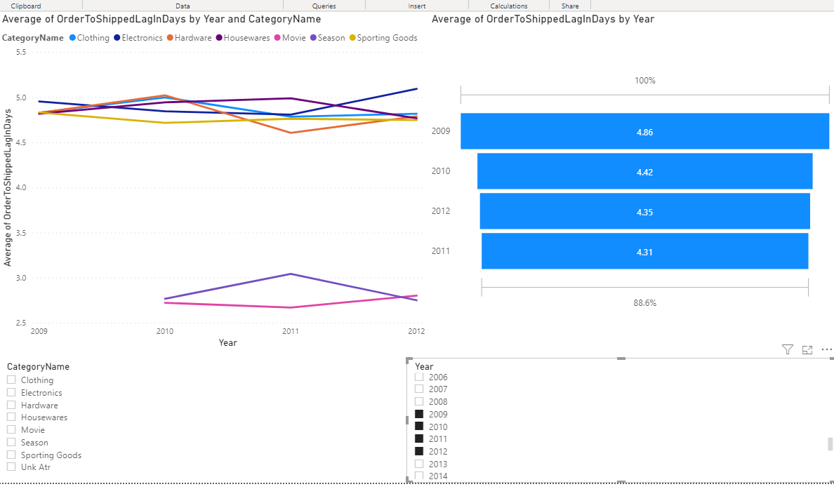
Average Order Fulfillment Time by Year
2013 was excluded as 2013 data only goes up to February.
The average across all of Fudgemix is skewed prior to 2010 since FudgeFlix has no data prior to 2010.

Slide 12
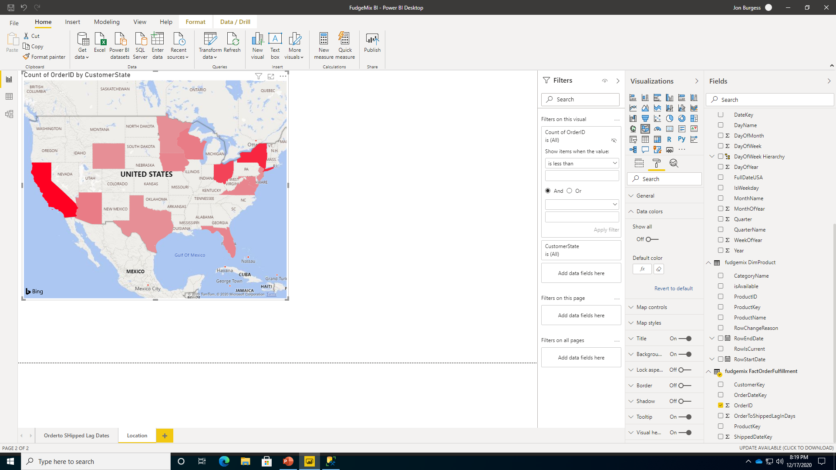
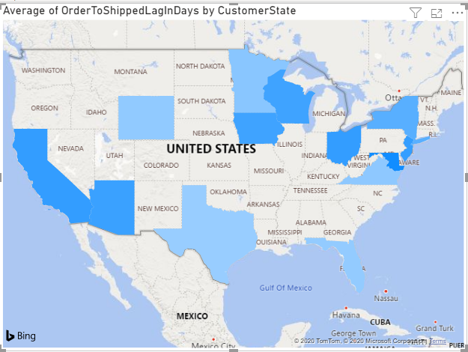
Total Orders by State Compared to Average Order Fulfillment Time by State

Slide 13
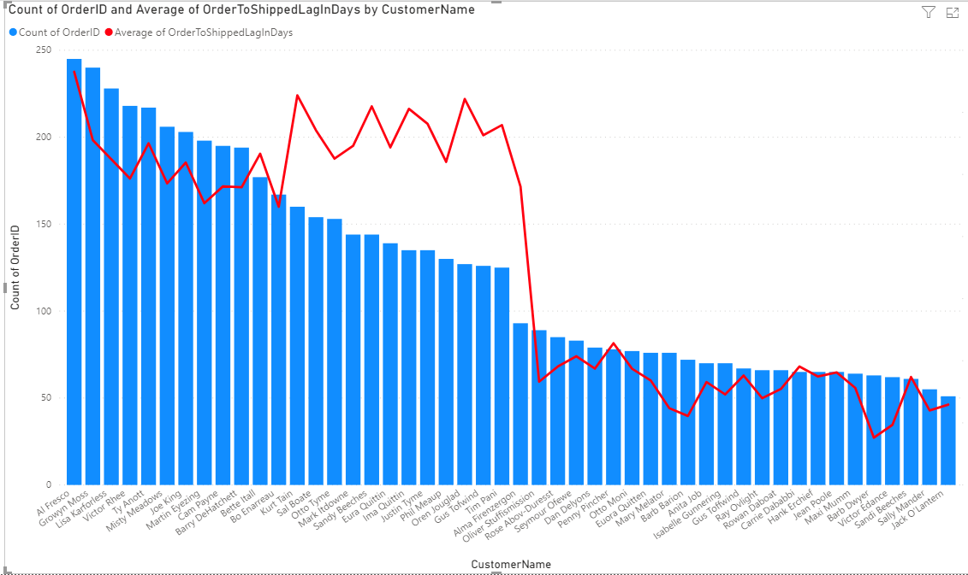
Total Orders by Customer and Average Order Fulfillment Time

Slide 14
Insights and Recommendations
July had the highest average fulfillment time at 4.69 days and January was the lowest at 4.24.
Fudgeflix data only starts in 2010.
The average fulfillment time for moves is approximately 3 days shorter than those of products. This dramatically lowered the average time from 2010 and on.
There does not appear to be any correlation between where a customer is located and the average lag time. The North East has both high and low counts of total orders and lag time, for example.
Order fulfillment time seems to have a direct relation with purchasing power. The more orders a client had, the slightly higher average fulfillment time.

